Slide 1
Project 5:Sentiment Analysis for Marketing
PHASE-5: PROJECT DOCUMENTATION & SUBMISSION

Slide 2
Problem Definition and Design Thinking
Problem Definition:
The problem is to perform sentiment analysis on customer feedback to gain insights into competitor products. By understanding customer sentiments, companies can identify strengths and weaknesses in competing products, thereby improving their own offerings. This project requires utilizing various NLP methods to extract valuable insights from customer feedback.

Slide 3
Importing libraries:
pip install numpy
import numpy as np
import pandas as pd
import tensorflow as tf
from sklearn.model_selection
import train_test_split
from sklearn.metrics
import accuracy_score
from tensorflow.keras.preprocessing.text
import Tokenizer
from tensorflow.keras.preprocessing.sequence
import pad_sequences
from tensorflow.keras.models
import Sequential
from tensorflow.keras.layers
import Embedding, Conv1D, GlobalMaxPooling1D, Dense, Dropout
import pickle5 as pickle

Slide 4
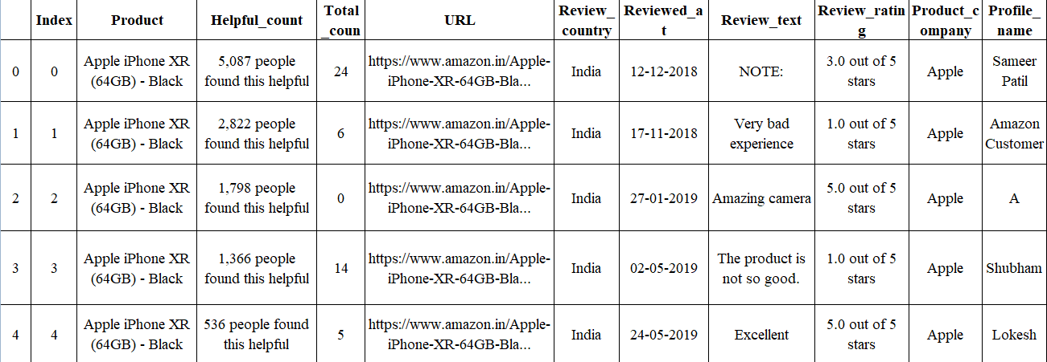
Data Reviews:

Slide 5
Preprocessing:
df.head()
df=pd.read_csv('/kaggle/input/apple-iphone-11-reviews-from-amazon-com/apple_iphone_11_reviews.csv‘)
df.isna().sum()
index 0
product 0
helpful_count 0
total_comments 0
url 0
review_country 0
reviewed_at 0
review_text 3
review_rating 0
product_company 0
profile_name 0
review_title 2
dtype: int64

Slide 6
df.dropna(inplace=true)
df.shape
df.info()
<class 'pandas.core.frame.DataFrame'>
Int64Index: 5007 entries, 0 to 5009
Data columns (total 12 columns):
# Column Non-Null Count Dtype
--- ---------- -------------------- --------
0 index 5007 non-null int64
product 5007 non-null object
helpful_count 5007 non-null object
total_comments 5007 non-null int64
url 5007 non-null object
review_country 5007 non-null object
reviewed_at 5007 non-null object
review_text 5007 non-null object
review_rating 5007 non-null object
product_company 5007 non-null object
profile_name 5007 non-null object
review_title 5007 non-null object
dtypes: int64(2), object(10)
memory usage: 508.5+ KB

Slide 7
df['reviewed_at']=pd.to_datetime(df['reviewed_at'])
print('All index column values are unique?: ',len(df.index)==df.index.nunique())
df.drop(['index'], axis=1, inplace=True)
All index column values are unique?: True
def find_likes(x):
likes=x.split()[0]
if likes=='One': return 1
elif ',' in likes: return int(likes.replace(',', ''))
else: return int(likes)
df['likes']=df['helpful_count'].apply(find_likes)
def find_rating(x):
rating=x.split()[0]
return float(rating)
df['rating']=df.review_rating.apply(find_rating)
df.rating.value_counts()
5.0 3730
4.0 718
1.0 319
3.0 153
2.0 87
Name: rating, dtype: int64

Slide 8
df.drop(['helpful_count', 'review_rating'], axis=1, inplace=True)
df.drop(['url'], axis=1, inplace=True)
numeric=df.select_dtypes('number').columns
categoric=df.select_dtypes('object').columns
print('Numeric Columns: ', numeric)
print('Categoric Columns: ', categoric)
outputs = model(input_ids, attention_mask)
predictions = outputs.logits.argmax(dim=1)
sentiment_counts = predictions.bincount()
sentiment_distribution = sentiment_counts / sentiment_counts.sum()
plt.figure(figsize=(10, 6))
plt.bar(['Positive', 'Negative'], sentiment_distribution)
plt.xlabel('Sentiment')
plt.ylabel('Proportion of Reviews')
plt.title('iPhone Amazon Reviews Sentiment Distribution')
plt.show()
plt.figure(figsize=(15,6))
for idx, col in enumerate(numeric):
plt.subplot(1, 3, idx+1)
sns.histplot(df[col], bins=15)
plt.title(col)

Slide 9
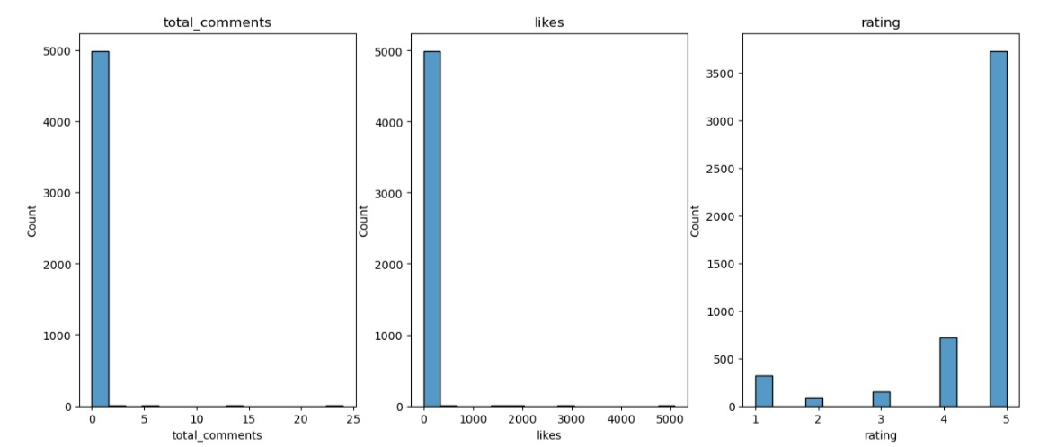

Slide 10
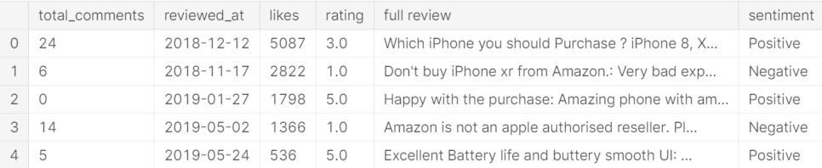
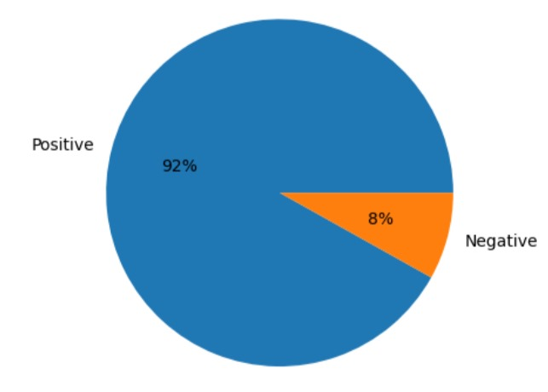
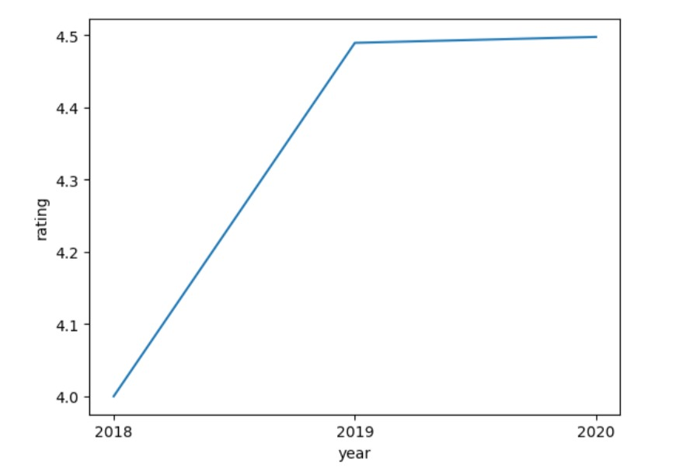

Slide 11
Feature engineering
df[numeric].describe()
for idx, col in enumerate(categoric):
if col=='review_text' or col=='review_title': continue
print(f'{df[col].nunique()} unique values found: {df[col].unique()}')
1 unique values found: ['Apple iPhone XR (64GB) - Black']
1 unique values found: [' India ']
1 unique values found: ['Apple']
4097 unique values found: ['Sameer Patil' 'Amazon Customer' 'A' ... 'Shreya' 'murali hv' 'basil john p']
df.drop(['product', 'review_country', 'product_company', 'profile_name'], axis=1, inplace=True)
def get_review(x):
return x.review_title+': '+x.review_text
df['full review']=df.apply(get_review, axis=1)
df.drop(['review_text', 'review_title'], axis=1, inplace=True)
df['sentiment']=np.where(df.rating>=3, 'Positive', 'Negative') plt.pie(df.sentiment.value_counts(), labels=df.sentiment.unique(), autopct='%.0f%%')

Slide 12
([<matplotlib.patches.Wedge at 0x7f36cb66ba90>, <matplotlib.patches.Wedge at 0x7f36cb6103d0>],
[Text(-1.0645015604617463, 0.2771938451237825, 'Positive'), Text(1.0645015799263142, -0.27719377037441, 'Negative')], [Text(-0.580637214797316, 0.15119664279479042, '92%'), Text(0.5806372254143531, -0.15119660202240542, '8%')])
nlp = spacy.load("en_core_web_sm")
df['full review'][50]
'Go for iPhone XR 256GB!: A lot of criticism of iPhone XR has been about its inability to take portrait pics of “only human faces!” Though true, it can be very easily overcome by downloading a software app - “Halide!” That and the near negligible difference in viewing experience, puts it on par with iPhone XS and even XS Max! Just go for it— the 256 GB storage version!‘
doc=nlp(df['full review'][50].lower())
for token in doc:
print(token)

Slide 13
go for iphone xr 256
gb ! : a lot
of criticism of iphone xr
has been about its inability
to take portrait pics of
“ only human faces !
” though True , it
can be very easily overcome
By downloading a software app
“ halide ! ” that
and the near negligible difference
in viewing experience , puts
it on par with iphone
xs and even xs max
! just go for it —
the 256 gb storage version !

Slide 14
tokens=[token for token in doc if not token.is_stop] tokens
[iphone, xr, 256, gb,
!, :, lot, criticism,
iphone, xr, inability, portrait,
pics, “, human, faces,
!, ”, true, ,,
easily, overcome, downloading, software,
app, -, “, halide,
!, ”, near, negligible,
difference, viewing, experience, ,,
puts, par, iphone, xs,
xs, max, !, —,
256, gb, storage, version, !]

Slide 15
tokens = [token for token in tokens if not token.is_punct] tokens
[iphone, xr, 256, gb, lot,
Criticism, iphone, xr, inability,
portrait, pics, human, faces, true,
easily, overcome, downloading, software, app,
halide, near, negligible, difference,
viewing, experience, puts, par,
iphone, xs, xs, max, 256,
gb, storage, version]

Slide 16
tokens = [token.lemma_ for token in tokens] tokens
['iphone', 'xr', '256', 'gb',
'lot‘, 'criticism', 'iphone', 'xr',
'inability', 'portrait', 'pic', 'human',
'face', 'true', 'easily‘, 'overcome',
'download', 'software', 'app', 'halide',
'near', 'negligible', 'difference', 'view',
'experience‘, 'put', 'par', 'iphone',
'xs', 'xs', 'max', '256',
'gb', 'storage', 'version']

Slide 17
' '.join(tokens)
'iphone xr 256 gb lot criticism iphone xr inability portrait pic human face true easily overcome download software app halide near negligible difference view experience put par iphone xs xs max 256 gb storage version‘
def preprocess(x):
doc=nlp(x.lower())
tokens=[token for token in doc]
tokens=[token for token in doc if not token.is_stop and not token.is_punct and not token.is_digit] tokens=[token.lemma_ for token in tokens]
return ' '.join(tokens)
df['clean text']=df['full review'].apply(preprocess)

Slide 18
import numpy as np
from sklearn.feature_extraction.text import TfidfVectorizer
from sklearn.naive_bayes import MultinomialNB
data = np.loadtxt('iphone_purchase_reviews.csv', delimiter=',', dtype=str)
vectorizer = TfidfVectorizer(stop_words='english')
X = vectorizer.fit_transform(data[:, 0])
X_train, X_test, y_train, y_test = train_test_split(X, data[:, 1], test_size=0.25)
clf = MultinomialNB()
clf.fit(X_train, y_train)
y_pred = clf.predict(X_test)
accuracy = np.mean(y_pred == y_test)
print('Accuracy:', accuracy)

Slide 19
import numpy as np
from sklearn.feature_extraction.text import TfidfVectorizer
from sklearn.naive_bayes import MultinomialNB
data = np.loadtxt('iphone_purchase_reviews.csv', delimiter=',', dtype=str)
vectorizer = TfidfVectorizer(stop_words='english')
X = vectorizer.fit_transform(data[:, 0])
clf = MultinomialNB()
clf.load('sentiment_analysis_model.h5')
y_pred = clf.predict(X[data[:, 1] == 'Evaluating'])
positive_reviews = np.sum(y_pred == 'positive')
negative_reviews = np.sum(y_pred == 'negative')
neutral_reviews = np.sum(y_pred == 'neutral')
print('Percentage of positive reviews:', positive_reviews / np.sum(y_pred) * 100)
print('Percentage of negative reviews:', negative_reviews / np.sum(y_pred) * 100)
print('Percentage of neutral reviews:', neutral_reviews / np.sum(y_pred) * 100)

